Slide 1
Chapter 6
Aggregate Supply and the Phillips Curve

Slide 2
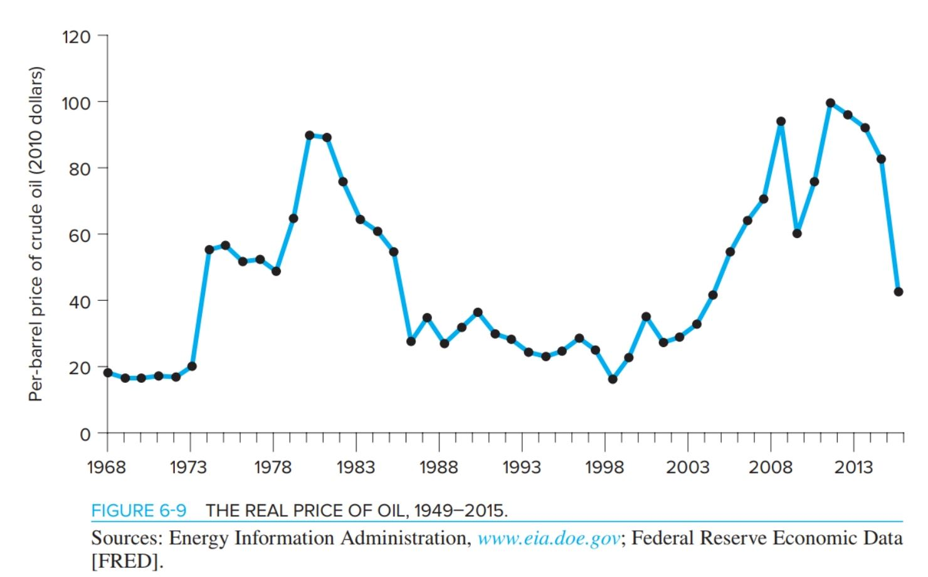
Adverse Supply shocks Resulting from an Increase in Price of Oil

Slide 3
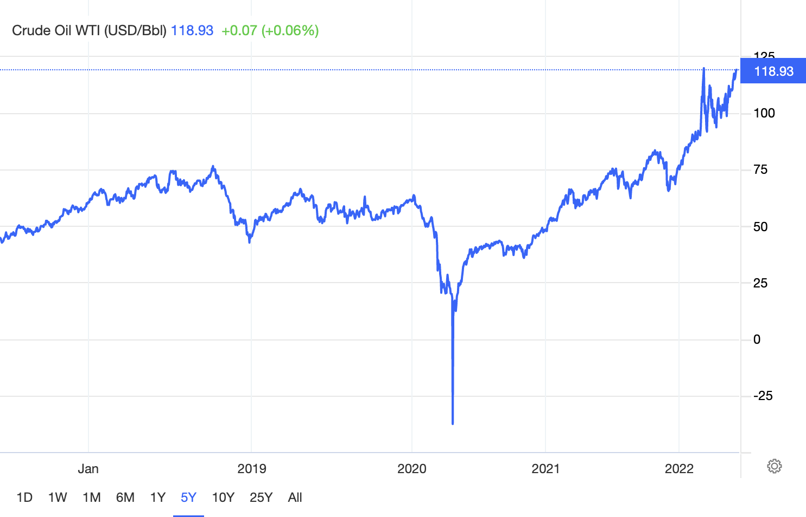
Negative Oil Prices!
How Oil Prices Turned Negative ???
- A Simple Explanation
https://www.youtube.com/watch?v=heb0U10BYOk

Slide 4
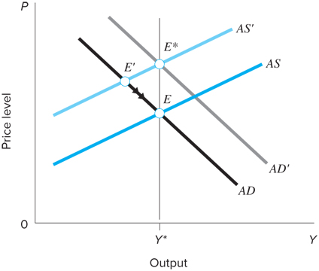
Adverse Supply shocks without Accommodating Policies
As AS shifts to AS’, equilibrium shifts from E to E’ and prices increase while output falls
The u at E’ forces wages and prices down until return to E, but process is slow
What happens to real wages in the long-run ???

Slide 5
Adverse Supply shocks with Accommodating Policies
Economy could move to E* if AD increase enough (accommodating policies)
Added inflation, although reduce u from AS shock
Accommodate the fall in the real wage at the existing nominal wage

Slide 6
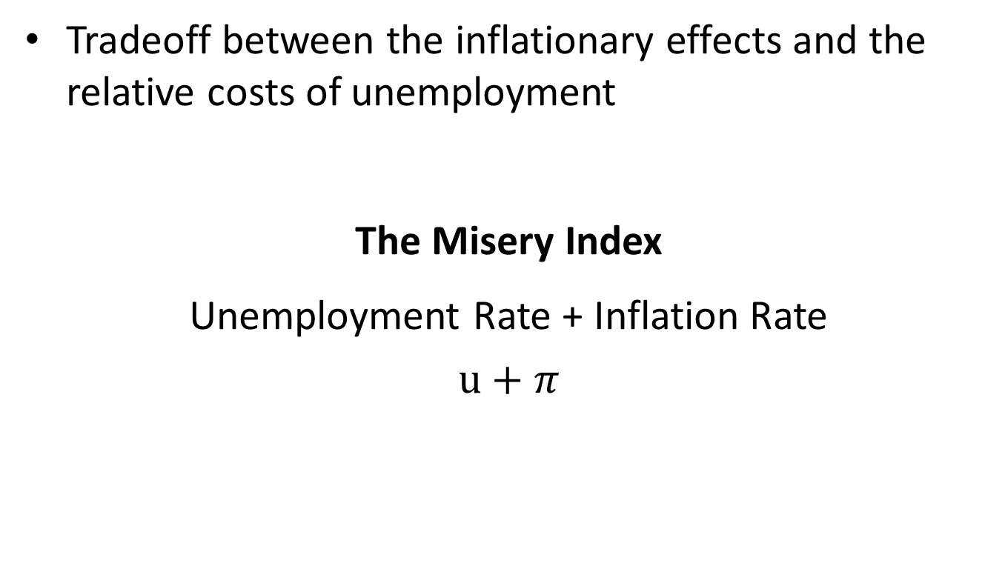
Why not enough Accommodating Policies in 1973-1975?
Tradeoff between the inflationary effects and the relative costs of unemployment
The Misery Index
Unemployment Rate + Inflation Rate
$$u+π$$

Slide 7
Why not enough Accommodating Policies in 1973-1975?
https://ycharts.com/indicators/us_misery_index

Slide 8
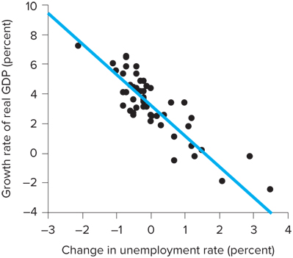
Costs of Unemployment
The greatest cost of unemployment = lost production
This cost is large: a recession can easily cost 3-5% of GDP and hundreds of billions of dollars
Okun’s law states that 1 extra point of unemployment costs 2% of GDP [See Figure]
Costs borne unevenly, largely by those who lose their jobs
Workers just entering the labor force and teenagers are amongst the hardest hit

Slide 9
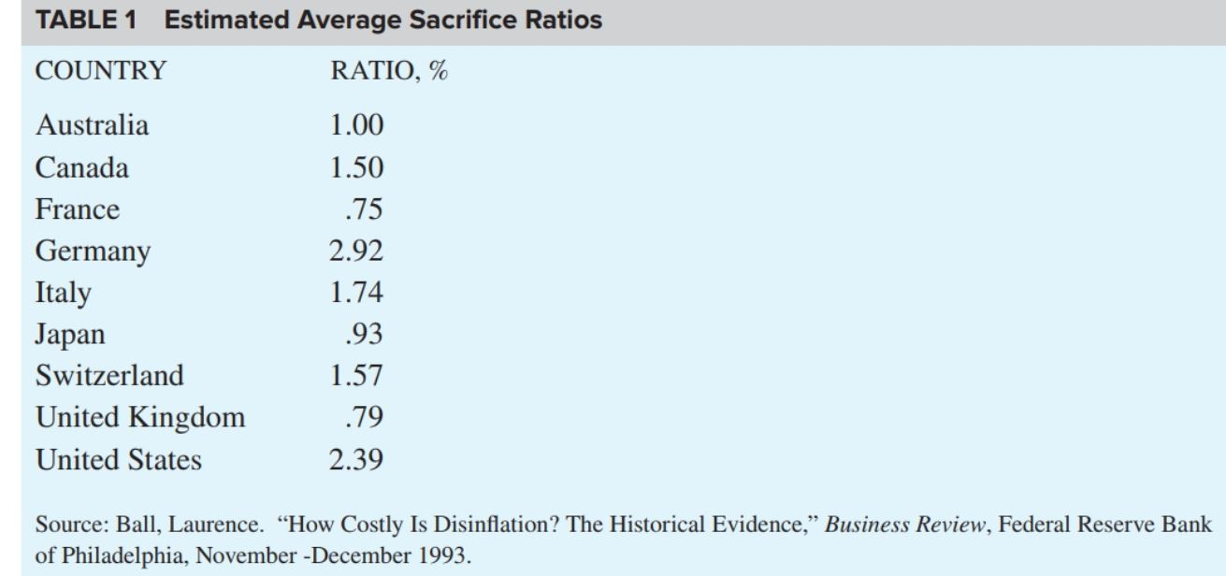
Costs of Change in Prices
The Sacrifice Ratio
The percentage of output lost for each one point reduction in the inflation rate

Slide 10
Example
Suppose the actual unemployment rate equals 5%, while the natural unemployment rate is 3%. Suppose the Okun’s coefficient equals 2.
Determine the rate of cyclical unemployment.
Use Okun’s law to determine the percentage change in the output gap.
Okun’s Law:

Slide 11
Political Business Cycle Theory
Studies interactions between economic policy decisions and political considerations
Building blocks:
What are the tradeoffs from which a policymaker can choose?
How do voters rate the issues?
What is the optimal timing for influencing election results?
Voters worry about both the level and rate of change of unemployment and inflation
Public worries about:
Rising unemployment
Inflation that differs from expectations

Slide 12
Political Business Cycle Theory
Policymaker wants economy pointing in the right direction at election time to maximize voter approval
Use restrictive policies early to raise unemployment and lower inflation
As election approaches, use expansionary policy to lower unemployment
This theory does not always work perfectly for the 4-year presidential cycle based on the U.S. empirical evidence (due to unexpected macroshocks, the role of FED, etc.)

Slide 13
Political Business Cycle Theory
Former New York Fed President Bill Dudley, in a post on Bloomberg (AUG 28, 2019), suggested the Federal Reserve could, and should, try to sway the election against President Donald Trump!
https://www.cnbc.com/2019/08/29/grossly-irresponsible-larry-summers-blasts-ex-fed-presidents-call-to-thwart-trump-in-2020.html

